Slide 1
Save the dates! LWCCN 2025 Webinars
29 May, 11:00 & 19:00 UTC
Creation care in the Workplace
4 September,11:00 & 19:00 UTC
Children & Young People in Creation Care
4 December, 11:00 & 19:00 UTC
Creation & the Arts

Slide 2
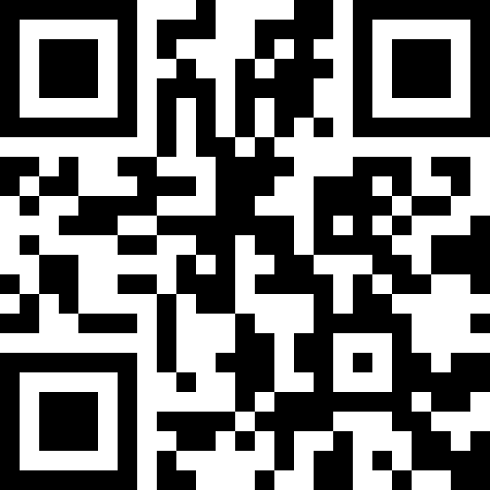
Sign up to LWCCN’s Pollinator enews!

Slide 3
Connecting to Care for our Common Home
Online communities meeting together and in small groups to restore, reinvigorate and reinspire Christian creation care activists.
contact: oikos@arocha.org

Slide 4
International Council for Evangelical Theological Education
3 – 7 March 2025, Tirana, Albania
Impact Team on Creation Care in Theological Education
contact: creationcare@icete.team

Slide 5
22nd April (or nearest suitable date)
https://www.earthday.org/earth-day-2025

Slide 6
Worldwide Family
Leaders Forum
Tagaytay, Philippines
10 - 17 May 2025

Slide 8
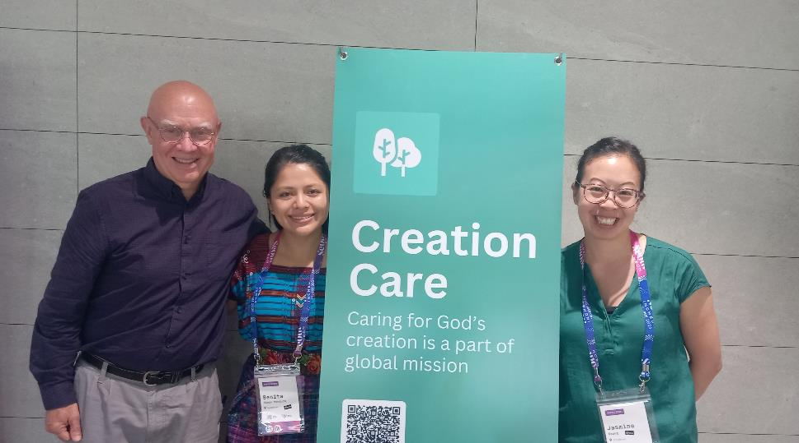
Lausanne Issue Networks Gathering
14-19 July 2025, Panama

Slide 9
1 September - 4 October 2025
2025 theme: Peace with Creation
https://seasonofcreation.org/

Slide 10
29 September - 2 October 2025
A time for us to envision, encourage, connect and equip ourselves as we walk together to bring hope in difficult times and hard places around the world.

Slide 11
Thu, 9 Oct 2025 -
Wed, 15 Oct 2025
The largest gathering of nature conservation experts, leaders and decision-makers in the world

Slide 12
World Evangelical Alliance General Assembly
MORE INFORMATION ON CREATION CARE CONTENT COMING IN FUTURE POLLINIATORS

Slide 13
COP 30
United Nations Climate Change Conference of Parties
Monday 10 Nov –
Friday 21 Nov 2025

